Slide 1

DESIGN THINKING
PHASE 1: FRONTEND DEV PROJECT
TECHBRIDGE COHORT 2022

Slide 2

WHAT IS EMPATHY?
HOW DOES EMPATHY WORK IN THE DESIGN PROCESS.

Slide 3
EMPATHIZE
Empathy is the ability to understand and share the feelings of another. It is also the first step in Design Thinking. In the interview we tried to place ourselves in their shoes to understand their specific needs. It is important to not jump to any conclusions or assumptions but listen intently to what the customer wants.

Slide 4

INITIAL INTERVIEW
SPECIALTY:
They specializes in selling rare and antique books from all over the world with multiple locations.
SCENARIO:
They have a large inventory of old rare books that are entered into the system via CSV sheets. They need to access the system and be able to add, update, and delete books out of the system. The website should be responsive, being able to be seen on multiple devices, including tablets, laptops, desktops, and mobile phones. The bookstore would also like the ability to search for books using genre, year, author, and title.

Slide 5
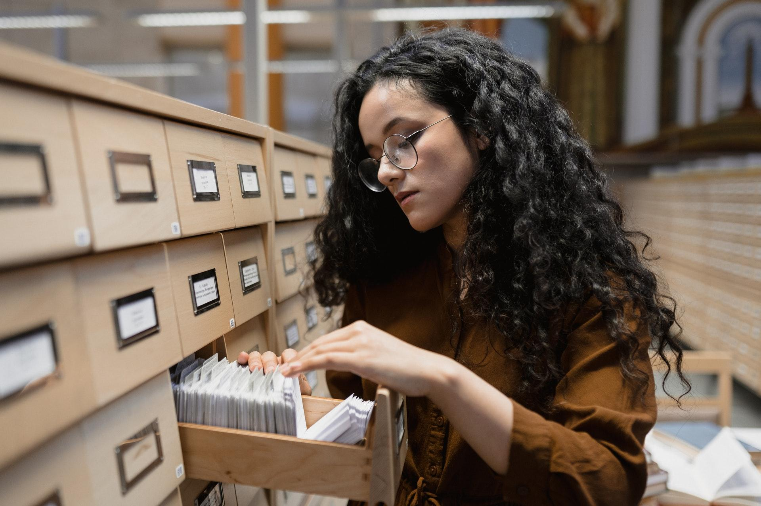
CATHERINE BRAUM
Age: 34
Personality: Friendly & Entrepreneurial
Gender: Female
Occupation: Bookstore Manager
Job Duties:
Controls, orders, and adds new inventory to systems.
Hires new employees and assigns tasks of operations.
Schedules employees working hours
Administers training and loss prevention.
Creates marketing campaigns
Assists customers with any complaints or queries.
Does not clean the shop
Does not cash out register.
Frustrations:
Frustrated with inventory being lost by inaccurate deletions.
Not able to see sitewide inventory which makes it difficult to restock.
Needs better archiving system for books in search querying.
Skills:
Microsoft Excel, Logistics,
Loss Prevention, Management,
Customer Service

Slide 6

Anthony Miller
Age: 26
Personality: Reserved, Scholarly, inquisitive
Gender: Male
Occupation: Book Store Attendant
Job Duties:
Adds inventory by entering information into excel sheets in the system.
Cash out register.
Cleans shop, maintains inventory, and creates engaging displays.
Assists customers by summarizing selection while providing customer service.
Does not have the ability to reorder stock
Can’t hire new employees.
Frustrations:
Feels the system is outdated, thinks they could save more time with new system.
Thinks most of their job relies on data entry by manually adding books.
Skills:
Data Entry, Social Media,
Customer Service,
Microsoft Excel, Business
Communication.

Slide 7
COMPARING PERSONAS
PERSONA 1: Anthony Miller
PERSONA 2: Victoria Braum

Slide 8
COMPARING PERSONAS
PERSONA 1: ANTHONY MILLER
PERSONA 2: VICTORIA BRAUM
Anthony finds that entering books into the current system, takes too much time to accomplish. Leading to customer service beinged hampered.
Anthony also stated that the current system makes it easy to make mistakes, which leads to many deletions.
Victoria finds it difficult training new hires with current system as it is very labor intensive and error prone.
Communication is difficult between locations about available inventory making customers frustrated as it is difficult to know iif something is available at another location.

